Slide 1

Design Masterclass Group 1
Design Masterclass.
Ubisoft.
Samuel Cook: Game Design & Art.
William Terry: Programming.

Slide 2
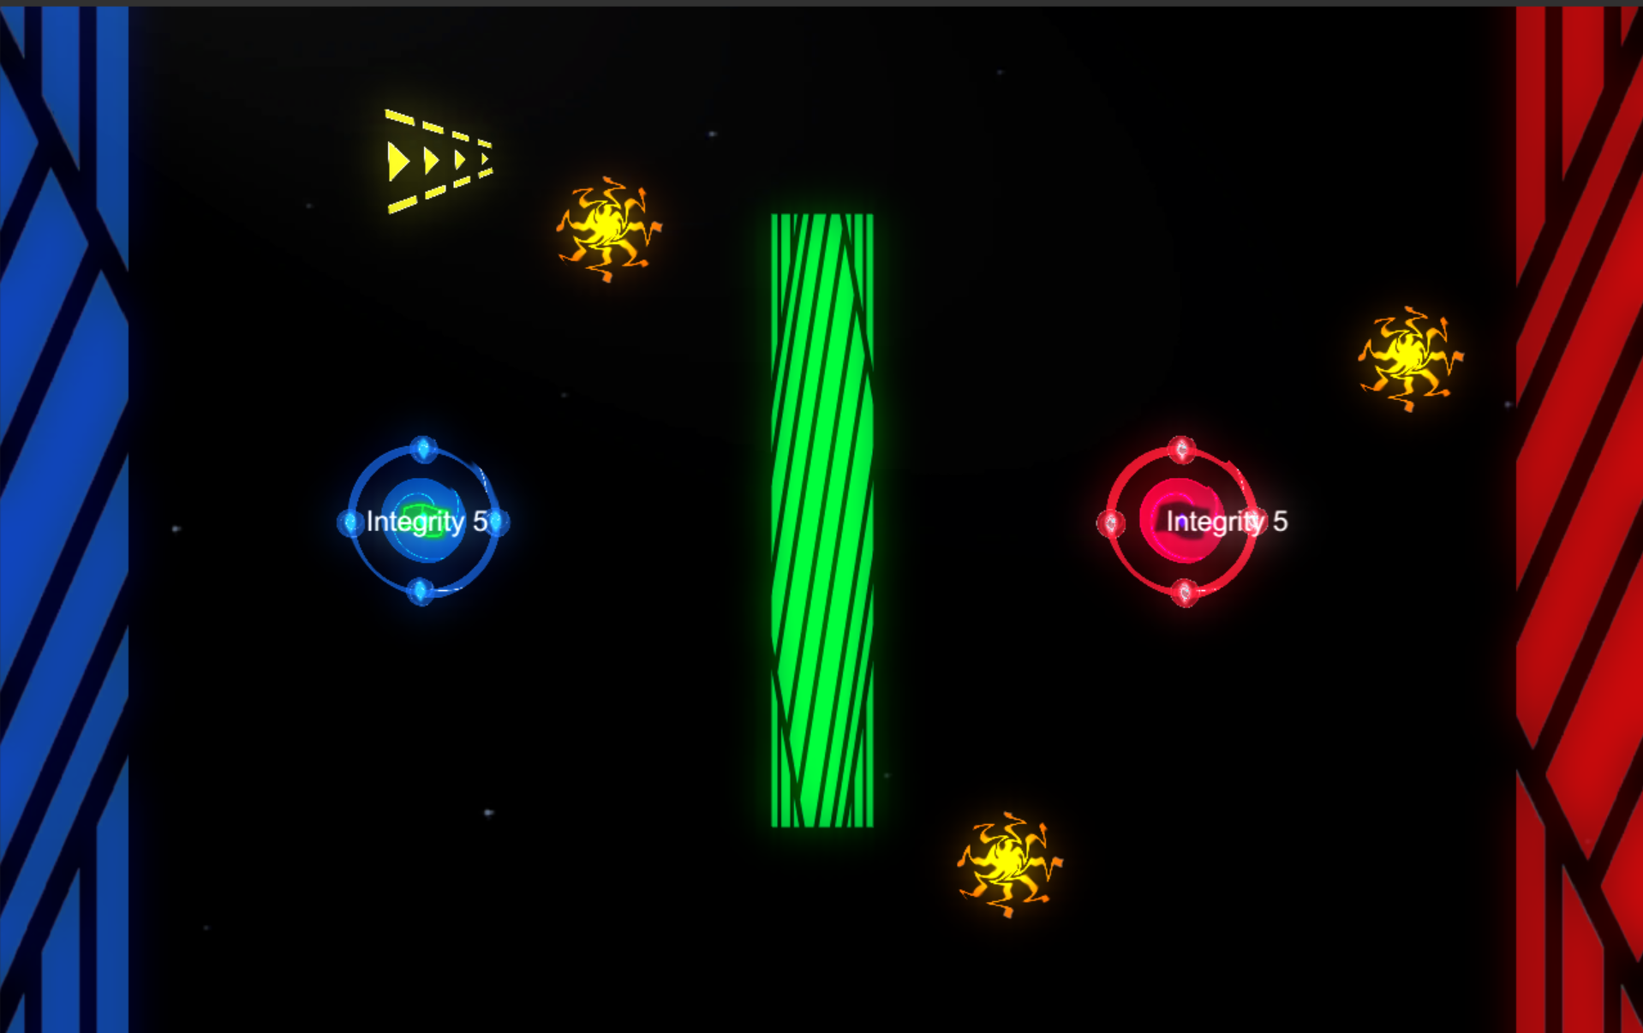


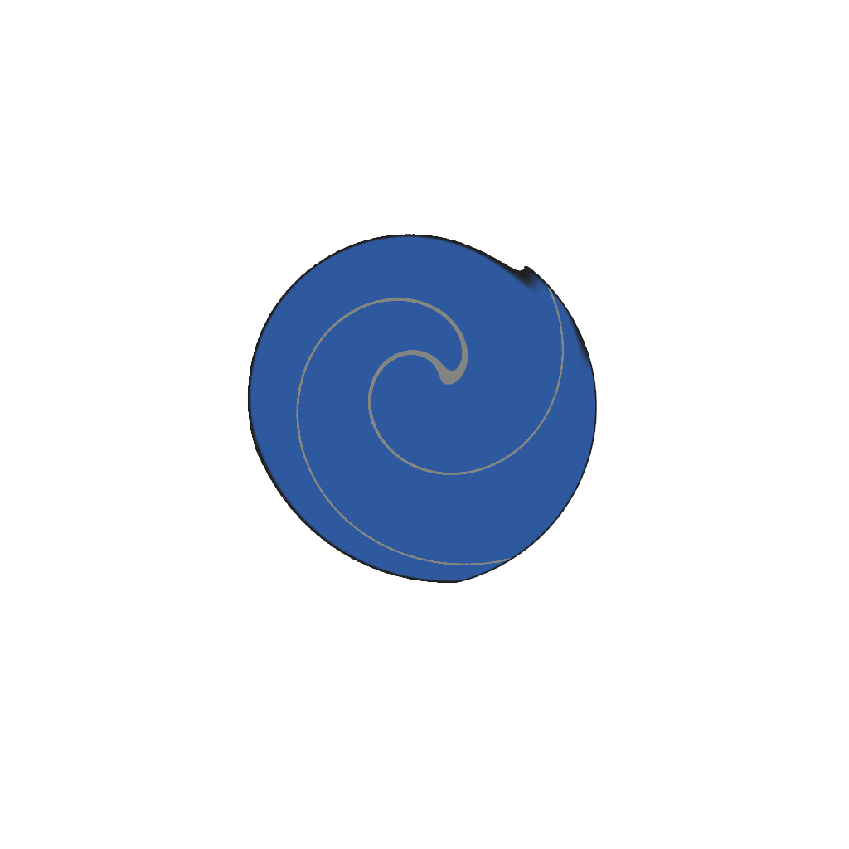
Player Actions.

Slide 3
Component Breakdown
Boosters can be placed in the game to speed up projectiles that fly through them.
Forcefields can be placed to block enemy projectiles reflecting them back the direction they came.
Singularities can be placed to block enemy asteroids and cause them to spin away randomly.

Slide 4
Design Deviations
Initially we had had the projectiles as a purchasable from the UI bar however this proved to be too many actions for the player to take at once as they also had to move the player at the same time
We made the player static and made the asteroids allways shoot from the players location.

Slide 5
Play Testing.

Slide 6
Questions?

